Slide 1
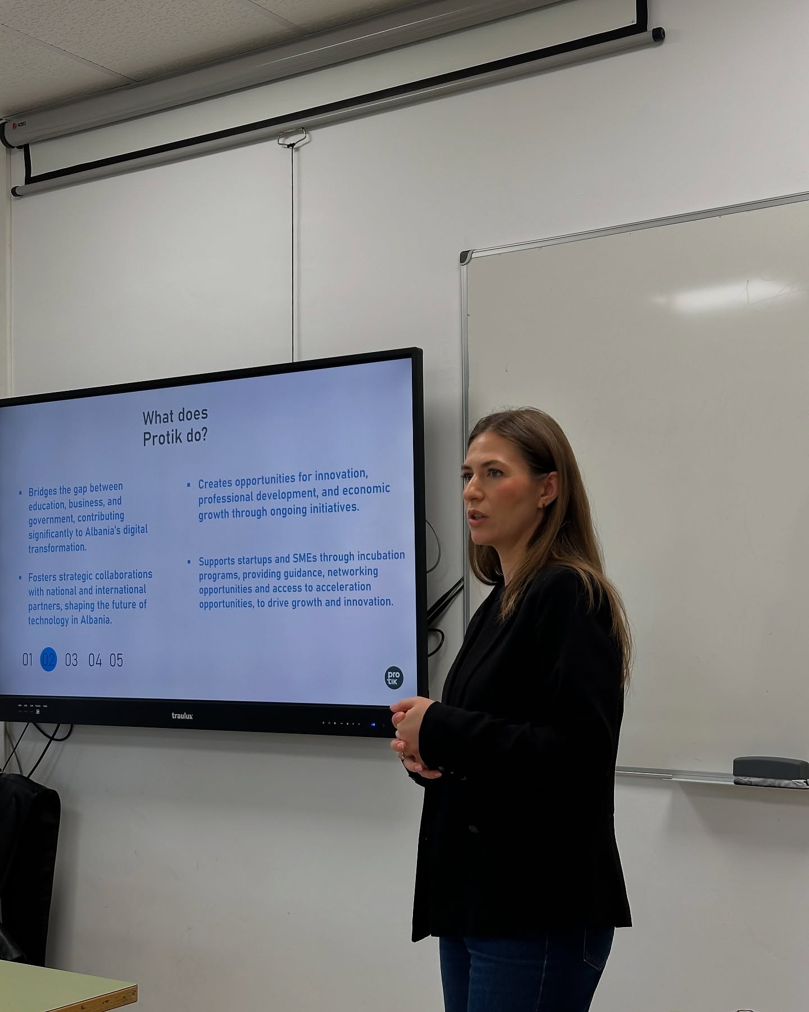


Professional Pitch Deck Templates for Investors
A comprehensive guide to creating impactful presentations and proposals

Slide 2



Why Use a Template
TEMPLATE BENEFITS:
⚡ SAVE TIME ON DESIGN.
💼 LOOK PROFESSIONAL INSTANTLY.
🧭 FOLLOW PROVEN INVESTOR-FRIENDLY STRUCTURE.

Slide 3


First Impressions
Creating a strong first impression is crucial in capturing your audience's attention. Engaging visuals and concise messaging can make a lasting impact. By strategically using design elements, like color and layout, you can convey professionalism and credibility, which helps establish trust with your audience right from the start.

Slide 4
Winning Design
KEY ELEMENTS FOR EFFECTIVE PITCHES
A strong design captures attention and conveys professionalism. Use consistent color schemes and fonts to enhance brand identity and engagement.
Incorporate visuals effectively to break up text and illustrate concepts. High-quality images and infographics can enhance understanding and keep the audience engaged.
Ensure that every slide has a clear focus. A well-structured layout helps maintain flow and makes it easier for investors to follow your message.

Slide 5
Save Time
Utilizing templates can significantly streamline your preparation process. By providing a structured format, templates allow you to focus on content rather than design. This efficiency ensures that you spend less time formatting and more time refining your message, which is essential for impressing potential investors.

Slide 6



Customization
Clarity
TAILORING TEMPLATES TO YOUR NEEDS
COMMUNICATING IDEAS WITH PRECISION
Effective pitch deck templates allow for easy customization, ensuring that each presentation can adapt to specific audience requirements while maintaining a consistent and professional look.
Clear and concise messaging is crucial for effective pitch decks. A well-structured template enhances understanding, helping to convey complex ideas succinctly while keeping the audience engaged throughout the presentation.

Slide 7



Essential Slides for Your Pitch
HERE ARE THE CRUCIAL SLIDES TO INCLUDE
Problem Statement: Define the issue you're addressing.
Market Analysis: Present data on your target market.

Slide 8
Easy Customization
Customizing your presentation is extremely straightforward. With our templates, you can easily replace text and images, adjust colors, and modify layouts to match your brand. The intuitive interface allows users to personalize their slides without extensive design knowledge, ensuring that your presentation maintains a professional tone while reflecting your unique style.

Slide 9
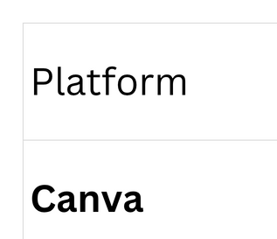
Platforms
EFFECTIVE PITCHING TOOLS

Slide 10
Boosting Success
Choosing the right template can significantly enhance your presentation and help convey your message effectively. A well-structured pitch deck not only captures the attention of investors but also provides a clear narrative that highlights your vision and objectives. This clarity can make a strong impact during crucial meetings.

Slide 11

01
A clear narrative is essential to guide your audience through your presentation, helping them understand your vision and goals effectively.
Key Takeaways for a Pitch Deck
02
Visuals play a crucial role in maintaining engagement; ensure your slides are aesthetically pleasing while conveying your message with impactful images and charts.
03
Practice delivering your pitch to ensure confidence and clarity; being well-prepared can significantly improve your chances of making a lasting impression.

Slide 12
Next Steps
To take your pitch further, it is essential to refine your message and ensure clarity in your delivery. Focus on engaging your audience by addressing their specific needs and demonstrating how your solution meets those needs effectively.

